Slide 1
New Entrants, Commercial Space and Changing Airspace Management
Dr. Ruth Stilwell
Presented to Airline Dispatchers Federation
October 2018 Chicago, IL , UsA

Slide 2
Who AM I?
Air traffic controller, Miami ARTCC 25 years
Executive Vice President of NATCA, 6 years
Served on the ICAO Air Navigation Commission as Industry Expert (IFATCA), 5 years
Current – Executive Director of Aerospace Policy Solutions, LLC
Research/Consulting firm currently under contract to FAA
Developed operational evolution strategy for integration of commercial space operation in the NAS
Currently developing concept for Cooperatively Managed Airspace above FL600

Slide 3
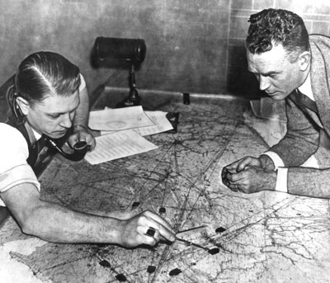
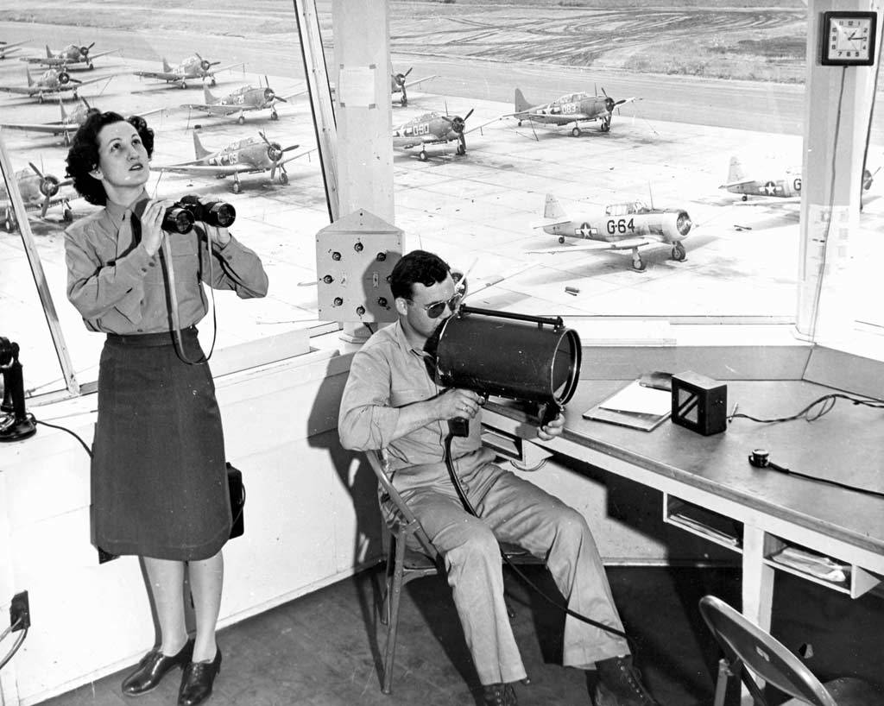
The changing Aviation Landscape – ATC THEN

Slide 4
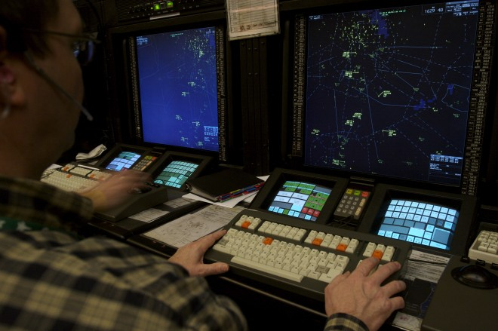
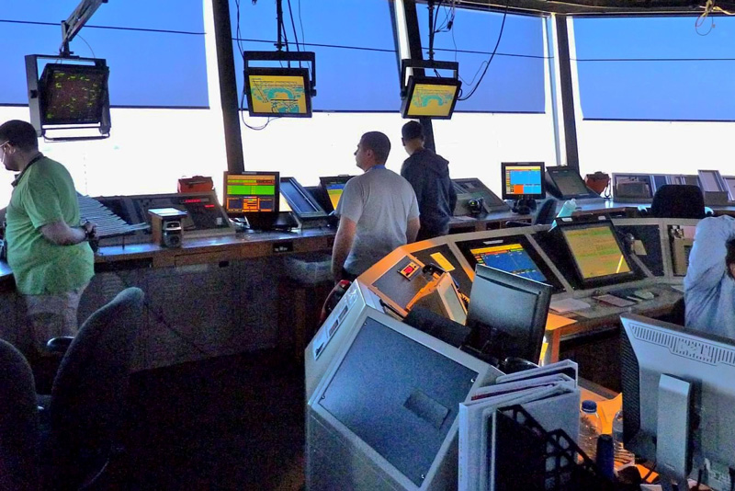
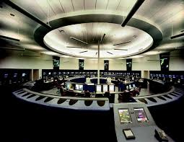
The changing Aviation Landscape - ATC Now

Slide 5
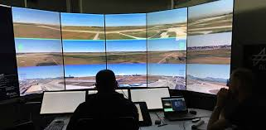
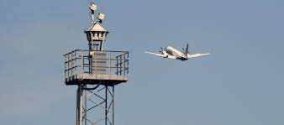
The changing Aviation Landscape - ATC Future?

Slide 6
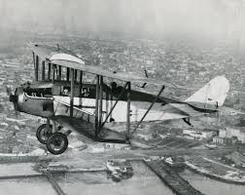
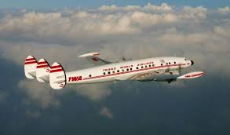
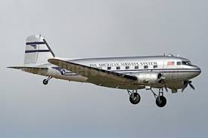
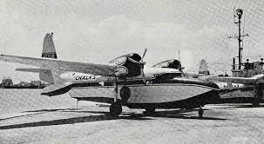
The changing Aviation Landscape – Airlines Then

Slide 7
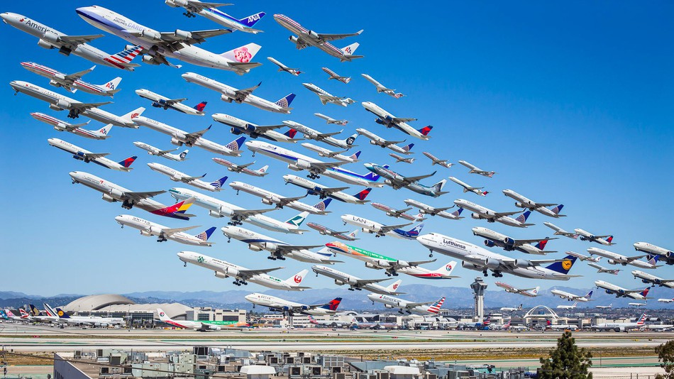
The changing Aviation Landscape – Airlines Now

Slide 8
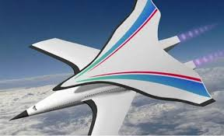
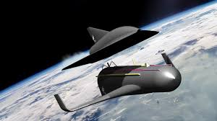
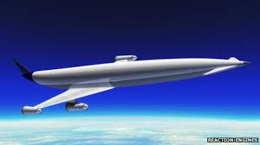
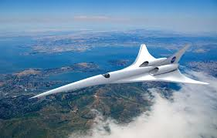
The changing Aviation Landscape – Airlines Future?

Slide 9
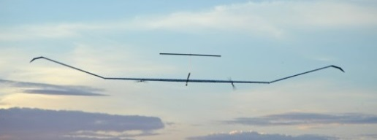
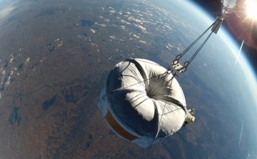
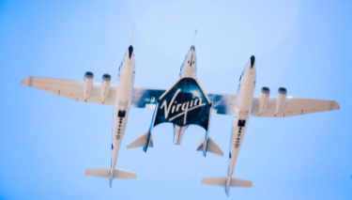
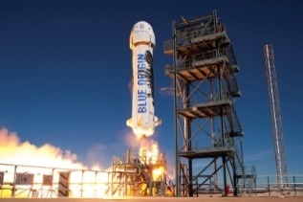
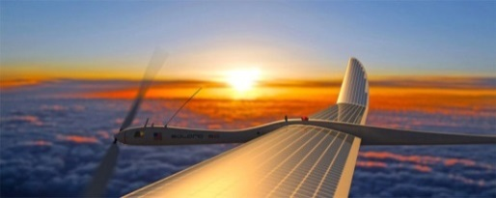
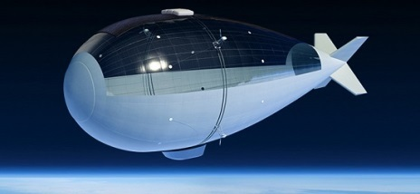
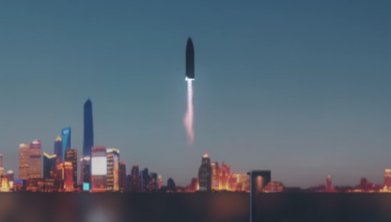
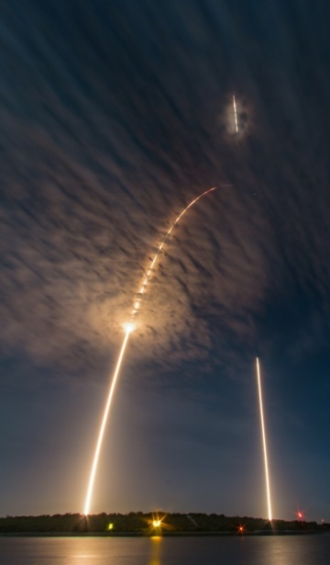
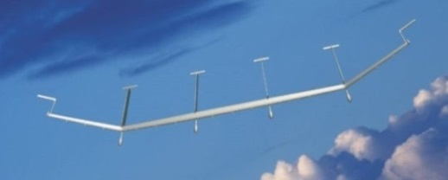
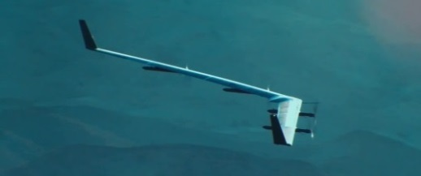
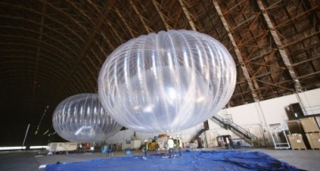
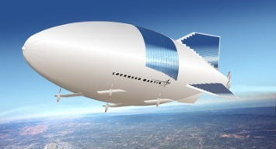
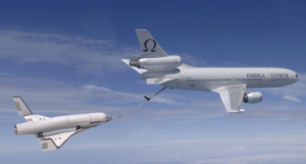
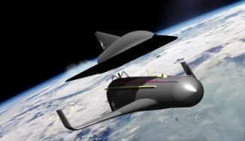
Reaching new heights – Space or Aviation?
Traffic population at altitudes above 20 km / 60.000 ft
Solar Powered HAPS
High Altitude Balloons, Airships
Suborbital Space Flights
Launcher, Spaceships
Operational altitudes approx. 60.000 - 90.000ft 300.000 ft 200km+
Communications Science Launch platforms Space transport
Technology demonstrations Surveillance Edge of space tourism / manned flights Satellites, Capsules, Orbiter

Slide 10
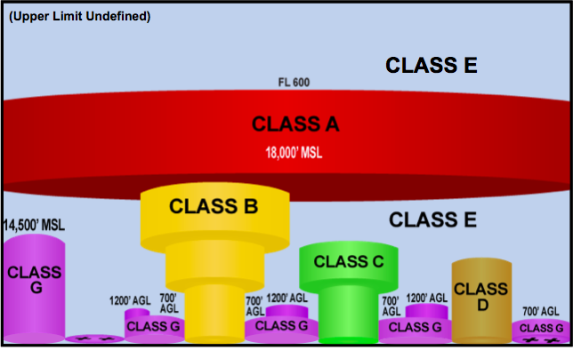
Perspectives
SPACE
space
100km
Near Space
328,000ft
High Altitude
20km
60,000ft
aviation
AVIATION

Slide 11
How is Upper Class E different from other airspace?
Airspace
Free from obstacles and terrain
Low density/demand
All aircraft known to ATC
Operator tracking information can augment ATC surveillance
Operations
Most aircraft are unmanned
Some flight plans not point to point
Long endurance flights
Mix between slow moving aircraft with limited maneuverability and high speed operations
Notes:
In addition to new challenges, Upper Class E presents an opportunity that doesn’t exist in other airspace.

Slide 12
Why does any of this matter to the Dispatch profession?
More launches
New aircraft types
New flight rules
New roles
Unpiloted, remotely piloted and optionally piloted aircraft
Blurs line between pilot and ATC
New interaction – operator and ATC

Slide 13
New ideas
Situational awareness tools and
cooperative traffic management
unmanned aircraft to operate in Class E airspace above FL600 with the
flexibility of VFR
Notes:
These are new concepts but they build on existing FAA approaches

Slide 14
Cooperative Airspace Management
The concept of cooperatively managed airspace progresses the FAA’s increasing information sharing and stakeholder engagement, including CARF, CDM, TIS-B, and ATOP.
The goal is to allow for conflict free route planning with tactical monitoring while ensuring system safety.
This builds on the current concept of monitoring and control by exception used in Oceanic airspace.
Develops new flight rules, X-FR, to allow unmanned aircraft with flexibility of VFR.
Notes:
We are already providing considerable amounts of shared operational information to commercial operations to support this concept, particularly for tactical monitoring. The challenge in exporting existing programs, like ATOP to do conflict free route planning is time. Many of the high altitude operators expect to remain in the airspace for several days or months. While the airspace is relatively uncongested this can be managed with manual systems, however, like all airspace, as demand increases, we will need automation support.

Slide 15
Flight Rules – Current Ops
Unmanned
IFR – 7200.23A “UAS flying under IFR should be handled the same as manned IFR aircraft…”
VFR – new flight rules needed
Space Vehicle Operations – same as other airspace categories
Manned
IFR – separation standards need to be clarified
VFR – not anticipated, but same rules as other airspace
Space Vehicle Operations –same as other airspace categories
Notes:
When we look a the existing flight rules and map them to users of Upper E airspace, we see that for manned aviation, space vehicle operations and unmanned IFR are covered under existing rules. The new challenge is unmanned “VFR” – there is a mismatch between the underlying principles of visual flight rules and high altitude unmanned operations

Slide 16
New Flight Rules X-FR
Flight Rules | IFR | VFR | X-FR
Traffic Avoidance | ATC separation | See and avoid | Detect and avoid
Traffic Advisories | From ATC to pilot | From ATC to pilot | Automated alert to operator
Distance from Traffic | ATC separation minima | Remain well clear | Remain well clear
Responsibility | ATC | Pilot | Operator
Notes:
To answer these questions, we need new flight rules to provide a regulatory structure that matches the type of operation.

Slide 17
conflict free route planning with tactical monitoring (Remain well clear)
Pilot
Controller
Dispatcher
Route Planning
Tactical Monitoring
Avoid Aircraft and Airspace

Slide 18
Shared Situational Awareness Picture

Slide 19
Additional Issues
Policies, Rules, Regulations, Licensing
Airspace Changes
Concept of Operations
Support Technology

Slide 20
Thank you and Questions?
Dr. Ruth Stilwell
Aerospace Policy Solutions, LLC
office@aerospacepolicysolutions.com

Slide 21
Back UP Slides

Slide 22
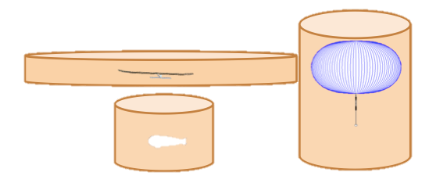
Remain Well Clear
Due to diversity in aircraft design and performance, different aircraft types may require different (user defined) volumes of airspace, both lateral and vertical, to ensure it its flight is not disrupted from wake or other encounter with traffic.

Slide 23
Airspace – Lateral
Present
Proposed

