Slide 1
Industry Update on Turbulence
Rick Curtis
Southwest Airlines Meteorology
ADF – 10/9/18

Slide 2
Turbulence Issues
Many Causes
CAT
Mountain Wave
Convection
Wake
Thermal
Difficult to Forecast
Difficult to Verify

Slide 3
Quiz
Question 1:
True or False: Most MDT or SVR turbulence reports occur at cruise altitudes?

Slide 4
Quiz
Question 1:
True or False: Most MDT or SVR turbulence reports occur at cruise altitudes?
False!
Statistics indicate that 70% of automated turbulence reports of MDT or great occur below 20,000 FT, with over 50% below 15,000 feet
source: American Airlines

Slide 5
Quiz
Question 2:
True or False: Most MDT or SVR turbulence reports occur in Clear Air Turbulence?

Slide 6
Quiz
Question 2:
True or False: Most Turbulence related accidents occur in Clear Air Turbulence?
False: Convection is the leading cause of turbulence related accidents.
source: NTSB

Slide 7
Quiz
Question 3:
Real-time Turbulence information is freely shared among major air carriers and the FAA?

Slide 8
Quiz
Question 3:
Real-time Turbulence information is freely shared among major air carriers and the FAA?
False: Real-time automated, generated turbulence is not shared today due to the lack of a central database, costly data distribution, along with proprietary data ownership issues. Excludes manual PIREPS.

Slide 9
US Civil Aviation Turbulence Accidents
Accident definition: ≥ substantial damage or ≥ serious injury

Slide 10
Turbulence Types in Part 121 Accidents: 2008-2016

Slide 11
Seasonality of Part 121 Turbulence Accidents: 2008-2016

Slide 12
Awareness

Slide 13
Manual PIREPs
Subjective
Dependent on Aircraft Type
Not always timely
Sparse reporting
Few null turbulence reports

Slide 14
Automated Turbulence Reporting
EDR – Eddy Dissipation Rate
Aircraft independent measure of the turbulence
(Courtesy of Delta Airlines)

Slide 15
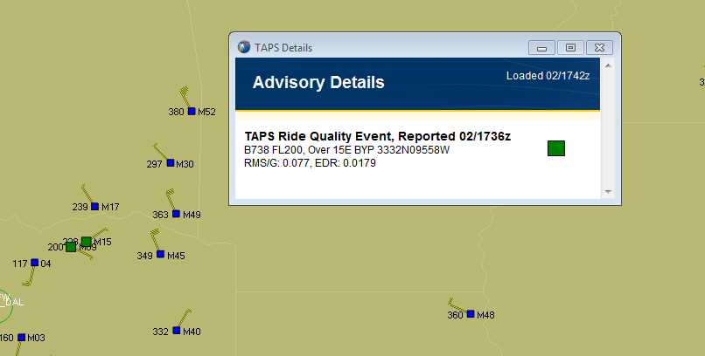
Automated Turbulence Reporting
TWC/IBM Turbulence Auto Pirep System (TAPS)
Turbulence Impact on a Specific Aircraft Type
Based on g-load thresholds

Slide 16
Automated Turbulence Reporting Issues
Start up and recurring costs to report data.
Differing EDR calculation methods.
“apples to apples”
Limited Q/A
“TAPS airlines” and “EDR airlines”
EDR limited display capabilities
Mechanisms not available for airlines to easily share EDR data
TAPS Data proprietary.

Slide 17
Turbulence Forecasting
GTG

Slide 18
Graphical Turbulence Guidance (GTG)
Forecast of Turbulence out to 18 hours of:
Mountain Wave
CAT
Low level Turbulence
Based on the RAP (Rapid Refresh) forecast model
13.5 km resolution
50 vertical layers
Updated hourly to 18 hours
Forecast Output – EDR with scale adjustment for specific aircraft types.

Slide 19
GTG Enhancements
Upgrading to the HRRR model
3 km resolution
Will Improve Low Level Turbulence
Adds Convective Induced Turbulence capability

Slide 20
GTG Enhancements
Upgrading to the HRRR model
3 km resolution
Will Improve Low Level Turbulence
Adds Convective Induced Turbulence capabilities.

Slide 21
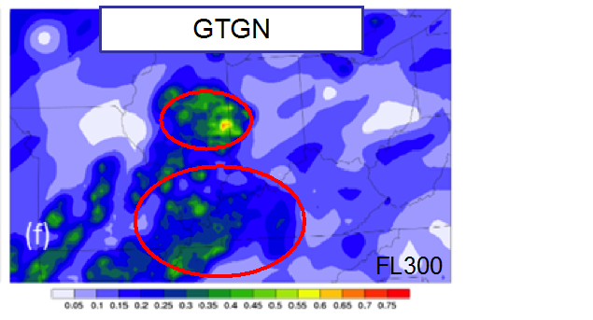
GTGN
Provides short-term forecasts of turbulence.
Uses GTG short-term forecasts combined with current EDR observations to provide 15 minute updates.
Currently in demo/evaluation phase (NWS-AWC & DAL)

Slide 22
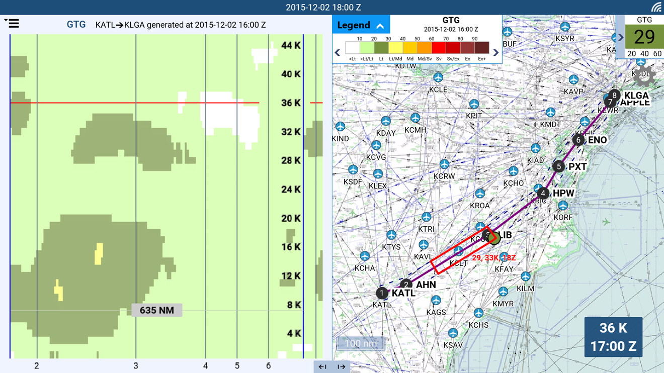
Delta Airlines EDR Application

Slide 23
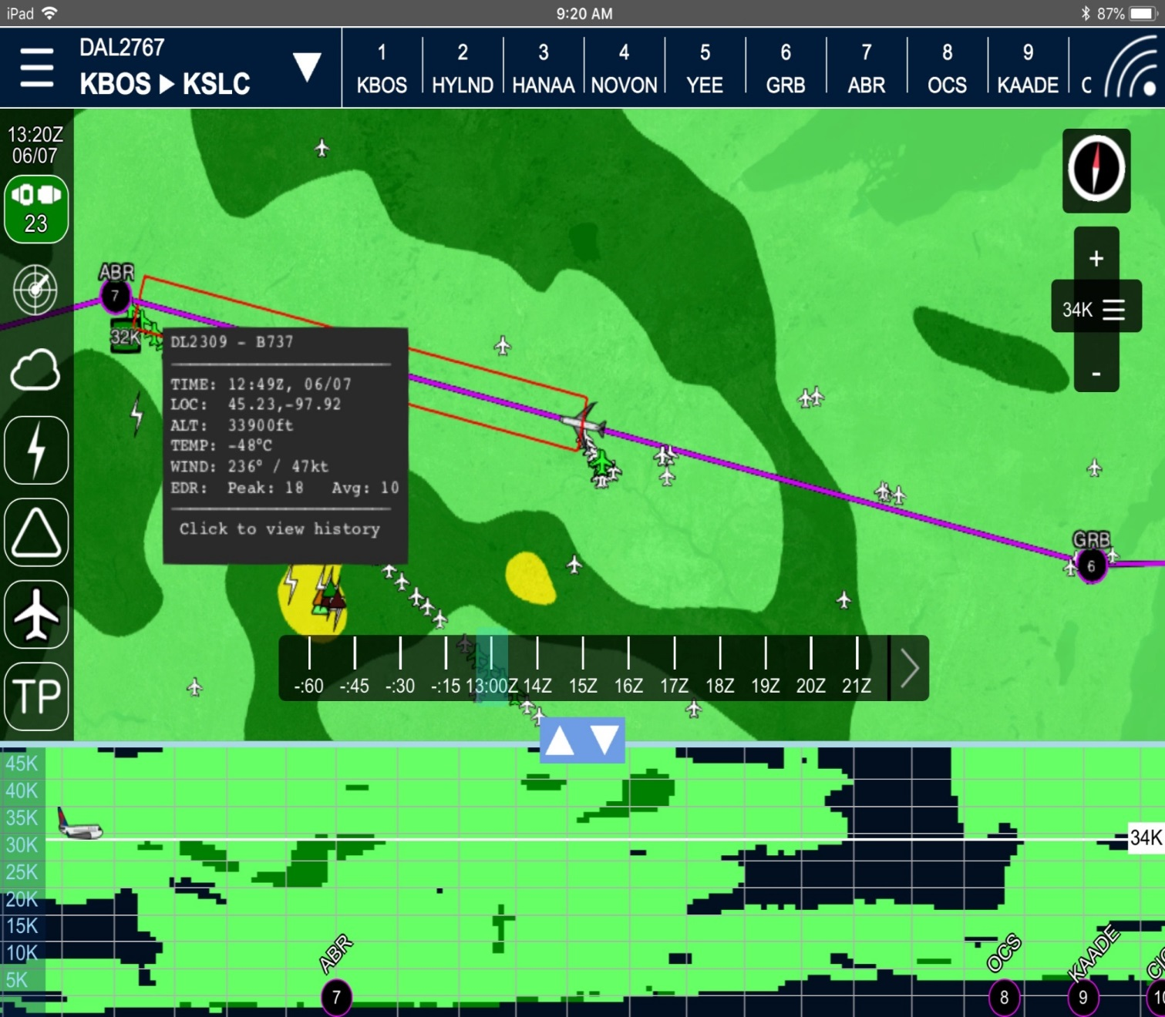
Delta Airlines EDR Application

Slide 24
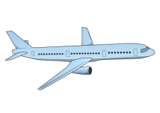
Current problem with turbulence data: Too little shared
Airline C
Airline B
Airline A
PIREPs
Automated Turbulence
Report
Automated Turbulence
Report
ATC
Airline OCC
Provider X
Current limitation: Too often the case with aircraft flying through turbulence
All 3 aircraft will hit the same turbulence because the data is too often not shared by ATC, nor between airlines or different solution providers
All available data needs to be shared to mitigate turbulence encounters globally
Airlines have requested IATA to be the global turbulence data consolidator
Notes:
True for both tactical and post-flight analysis

Slide 25
IATA’s role is to facilitate ground-to-ground
turbulence data sharing amongst airlines
Automated Turbulence
Report
IATA’s Role
IATA Global Turbulence Database
(simple real-time data deidentification , security and aggregation)
Ground Server (either airline, or SITA/ARINC/ or airline’s third party
Airline Operation Control Center (ground server) for operational use***
Airline requests data from IATA database
Ground-to-ground data transfer to IATA
IATA sends data back to airline ground server
IATA’s role is to receive existing airline data from ground servers, consolidate data into one database (managed by a specialized, IATA contracted database vendor), and
upon request provide the data back to airlines via ground-to-ground transfer
***Airlines are free to decide how to use the data operationally with their existing dispatch or airborne alerting tools
Notes:
Types of data, promoting NCAR EDR as strong position on data ownership rights by airlines

Slide 26
Highly Collaborative Development
IATA Turbulence Advisory Group:

Slide 27
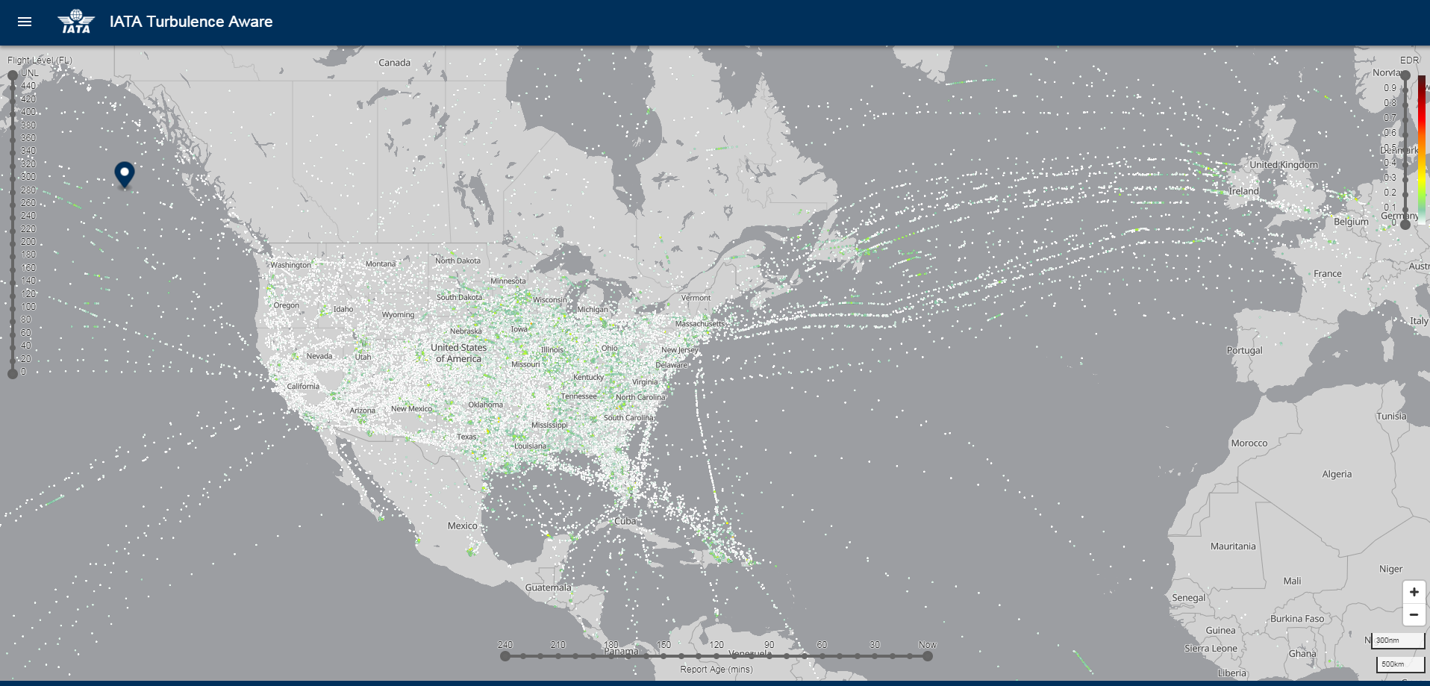
Basic Turbulence Viewer

Slide 28
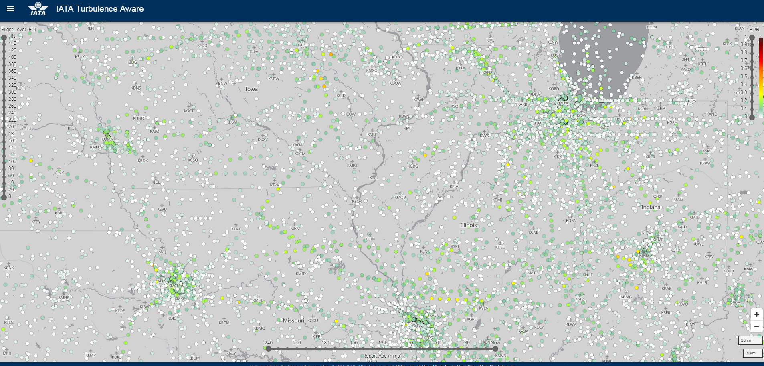
Basic Turbulence Viewer: Color Coded Reports

Slide 29
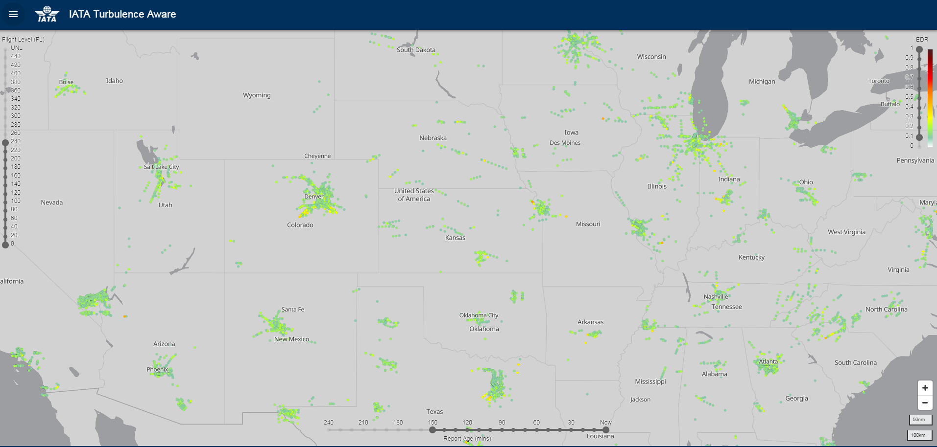
Basic Turbulence Viewer: Altitude, Time, EDR Sliders

Slide 30
Rick.Curtis
Southwest Airlines
rick.curtis@wnco.com

